Slide 1

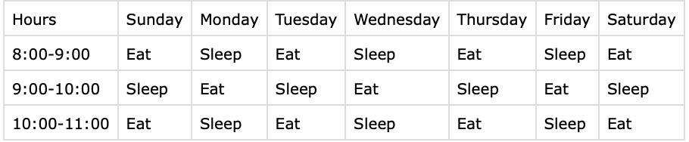
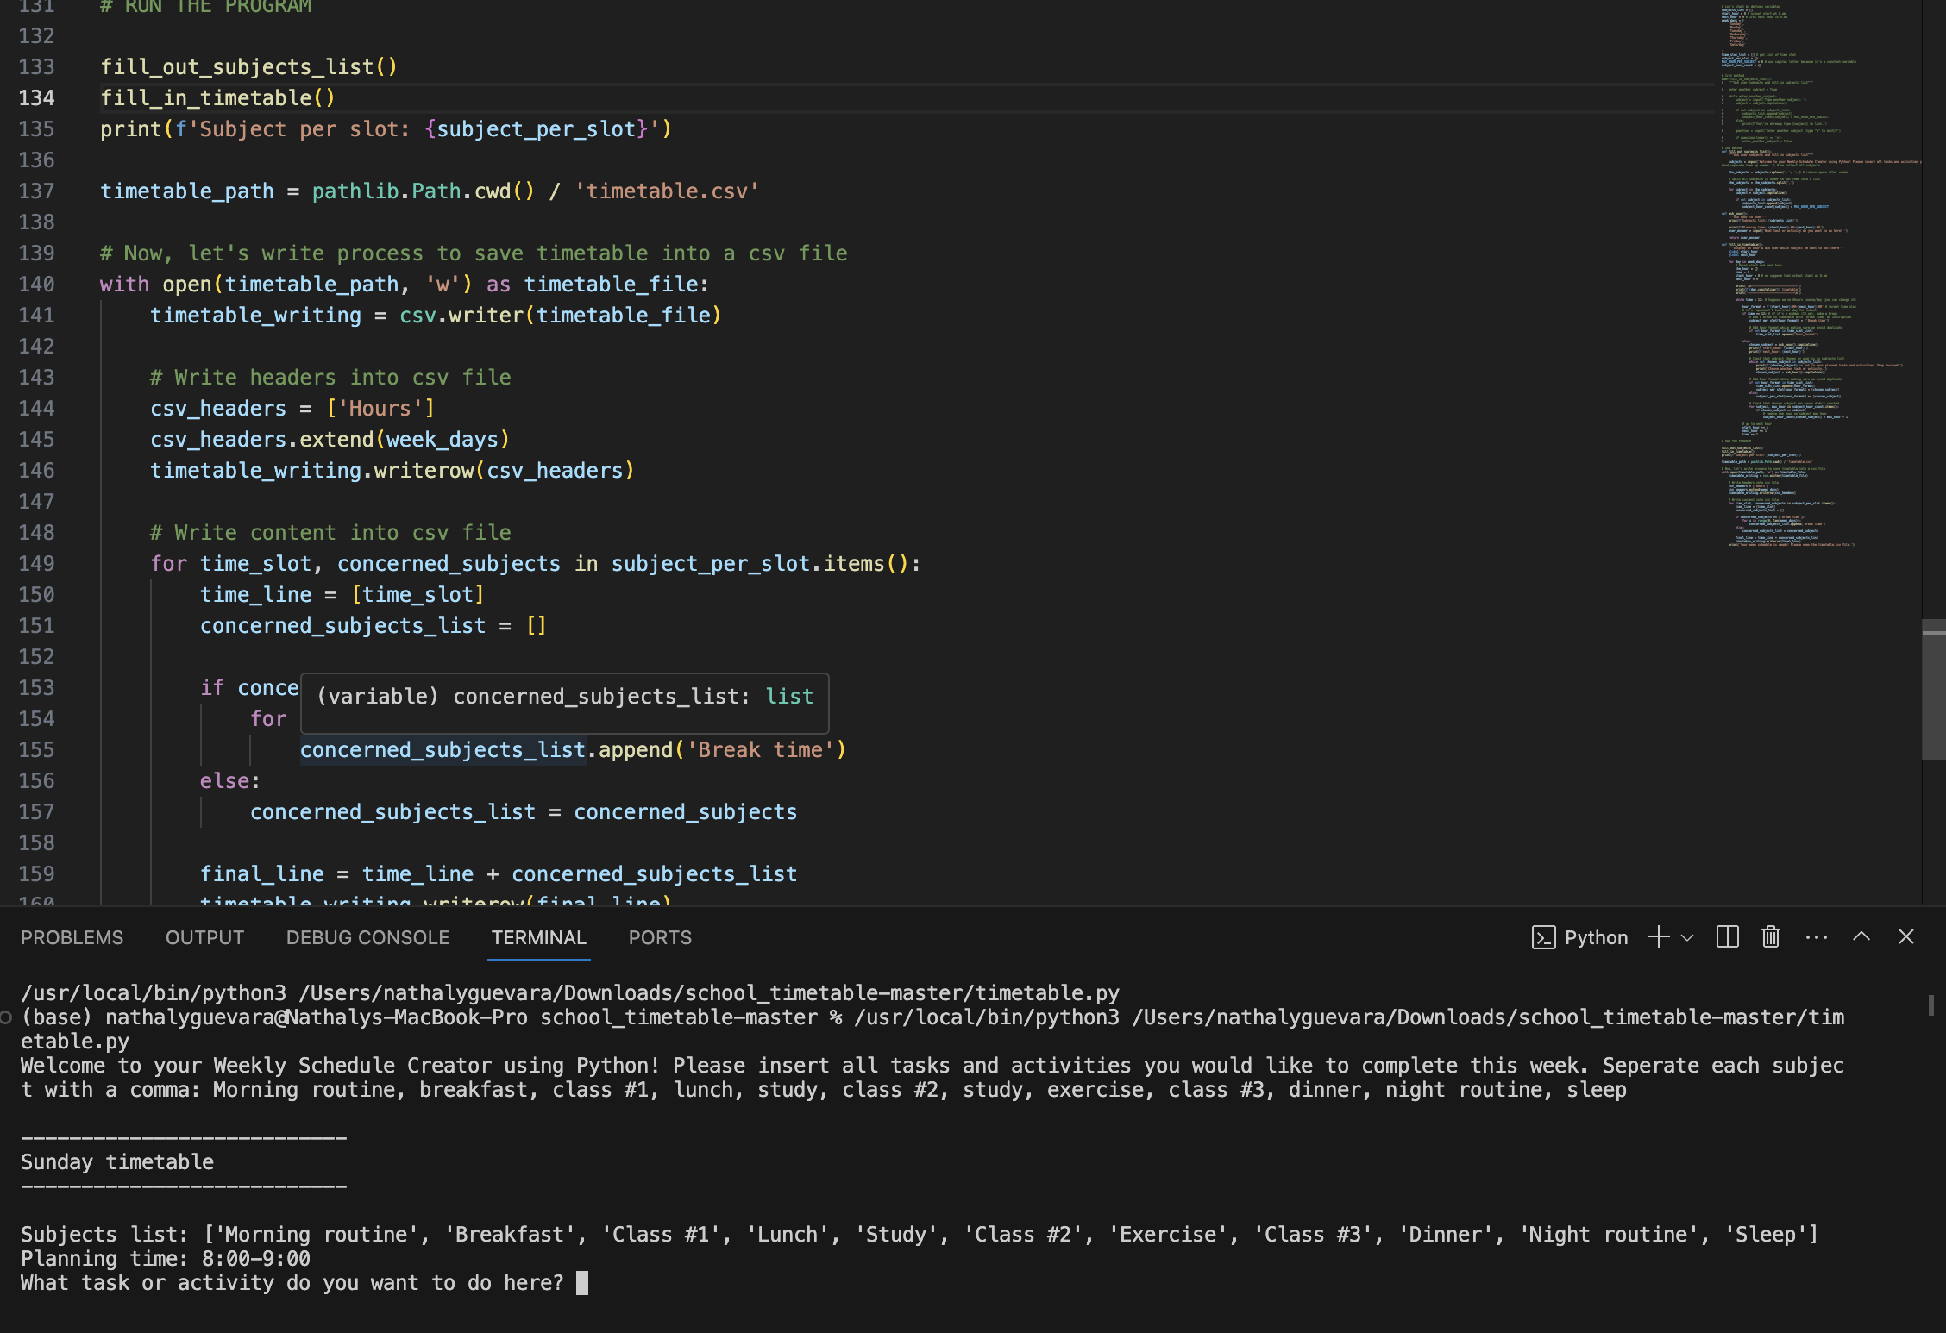
Weekly Schedule Creator
www.github.com/ksu-is/weekly-schedule-creator
A simple, yet smarter way to code and organize your week!
Team Members: Nathaly Guevara

Slide 2

Source code(s)
Schedule Creator By Tech with Tim
School Timetable by Boanerges7
https://github.com/techwithtim/Schedule-Creator
Failed to utilize efficiently due to complicated coding issues
https://github.com/Boanerges7/school_timetable/tree/master
Coding was easy to edit and understand. Had exactly what I needed!

Slide 3
Project Timeline
April 8th: Chose and submitted project idea for a weekly calendar using python!
April 9th: Found my first source code and began editing
April 20th-25th: Changed source code due to complexity of previous choice, began editing
April 25th: Finalized coding structure

